Slide 1


The Appliances Energy Consumption: Time-Series Forecasting
Professor: Wiao Lexian
- Joshitha Mandali

Slide 2


Time-Series Forecasting
Data or observations : Regular time intervals
Predict what will happen in the next time period
History often repeats itself
Prediction is based on given time - Different from other models
Examples:
Smart homes : Temperature, number of people in the house and Energy usage

Slide 3

Amazon : Assets are moving across the world with a fine-grained level of precision and efficiency that makes same-day delivery possible
Three commonalities: Data arrives is recorded as new entry: Data arrives in time order; Time is primary axis
These data sets are generally append-only. The data that has been recorded doesn't change since it was recorded at some point in the past.
Time series data: Analyze the past; Monitor the present; Predict the future

Slide 4
Time-SERIES FORECASTING MODELS
Auto Regression (AR)
Moving Average (MA)
Auto Regressive Integrated Moving Average(ARIMA)
Seasonal Autoregressive Integrated Moving-Average (SARIMA)
Seasonal Autoregressive Integrated Moving-Average with Exogenous Regressors (SARIMAX)
Vector Autoregression Moving-Average (VARMA)
Vector Autoregression Moving-Average with Exogenous Regressors (VARMAX)
Long Short-Term Memory (LSTM)

Slide 5
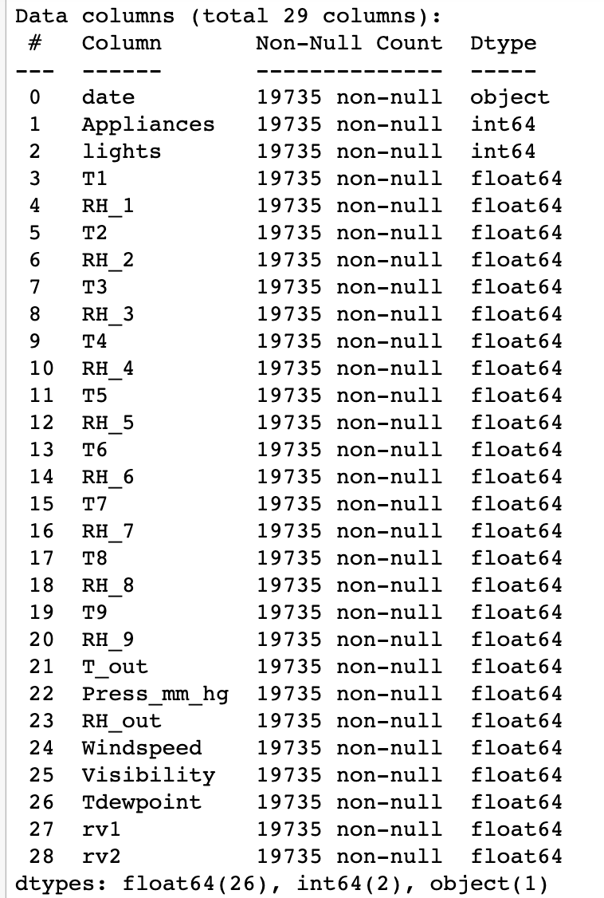
Dataset
Appliances Energy Consumption; Multivariate dataset
Energy consumption from different appliances extracted for about four months (from 1/11/2016 to 5/27/2016)
UCI Machine Learning Repository
Shape: 19735 rows, 29 columns
1 date time column, 2 Integer columns and 26 Float column
No null values
Predict the Energy consumption by Appliances
Python language and Jupyter notebook

Slide 6
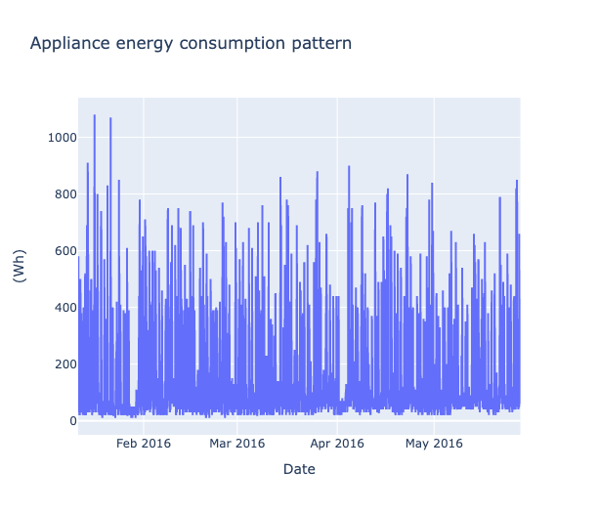
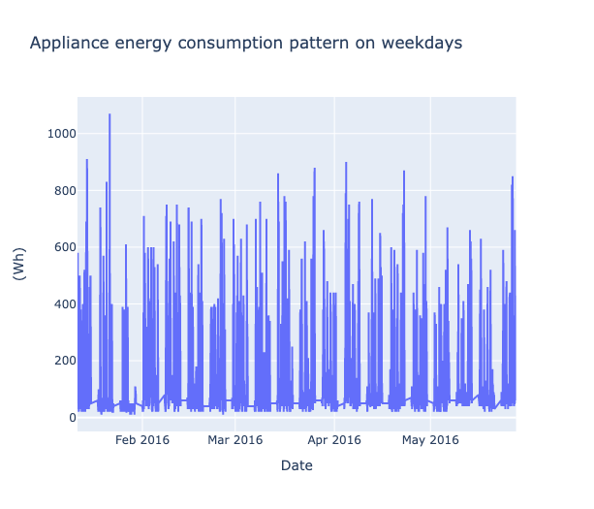
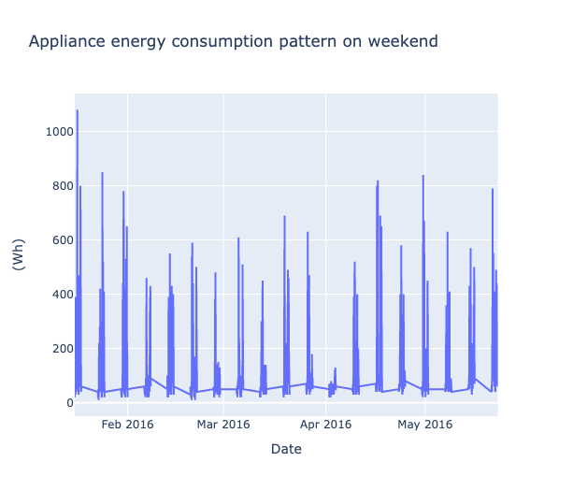
Data Visualization

Slide 7
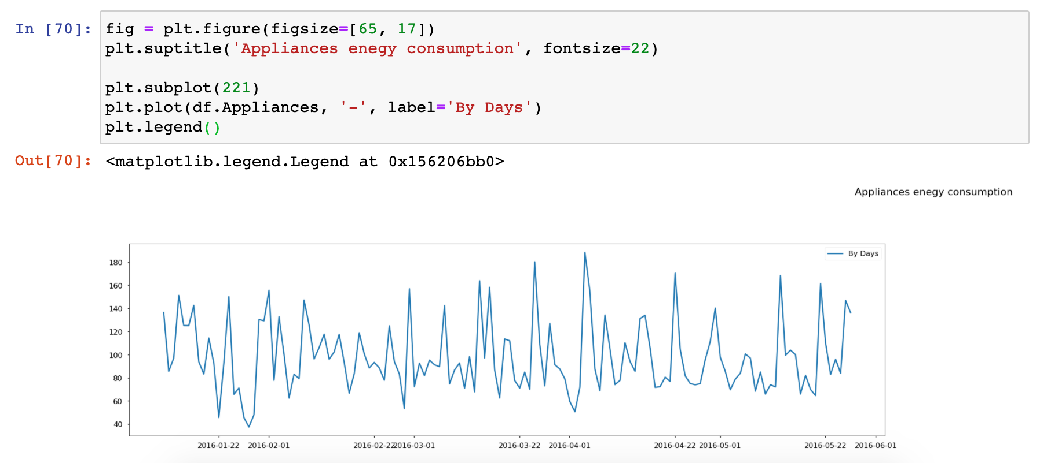
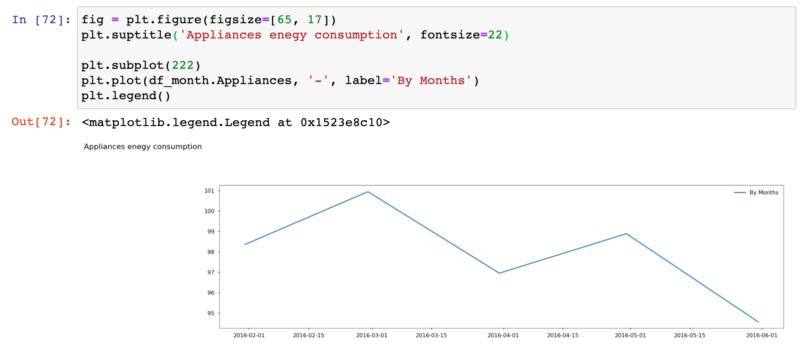
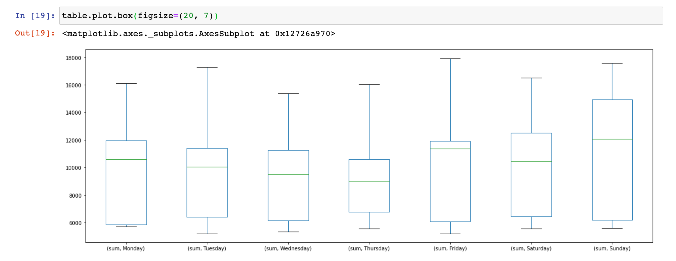

Slide 8
Auto Regressive Integrated Moving Average (ARIMA)
ARIMA specified by three order parameters: (p, d, q)
Combination of two models:
AR (p) Auto Regression : An auto regressive (AR(p)) component refers to the use of past values in the regression equation for the time series
I(d) Integration: Uses differencing of observations (subtracting an observation from observation at the previous time step)
MA(q) Moving Average: A moving average component depicts the error of the model as a combination of previous error terms. The order q represents the number of terms to be included in the model
Various flavor's of ARIMA model:
ARIMA: Non-seasonal Auto Regressive Integrated Moving Averages
SARIMA: Seasonal ARIMA
SARIMAX: Seasonal ARIMA with exogenous variables: Exogenous variables are also called covariates and can be thought of as parallel input sequences that have observations at the same time steps as the original series

Slide 9
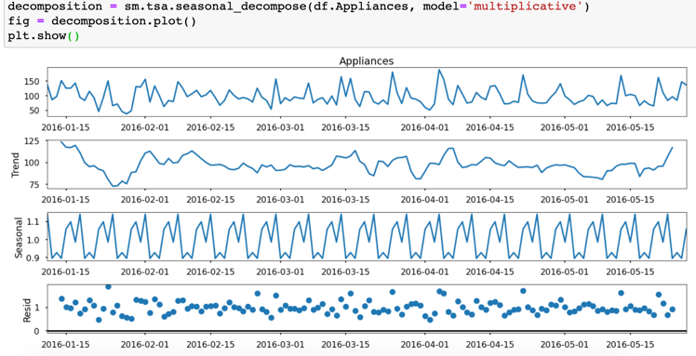
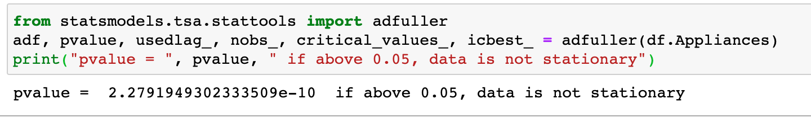
Dickey- Fuller test: to find if data is stationary or not
Here it clearly shows the data is stationary. (if above 0.05, data is not stationary)
How does the trend, seasonal and residual look on the dataset?
Seasonal — pattern occurs when a time series is affected by seasonal factors
Can see how seasonal it is with the graph

Slide 10
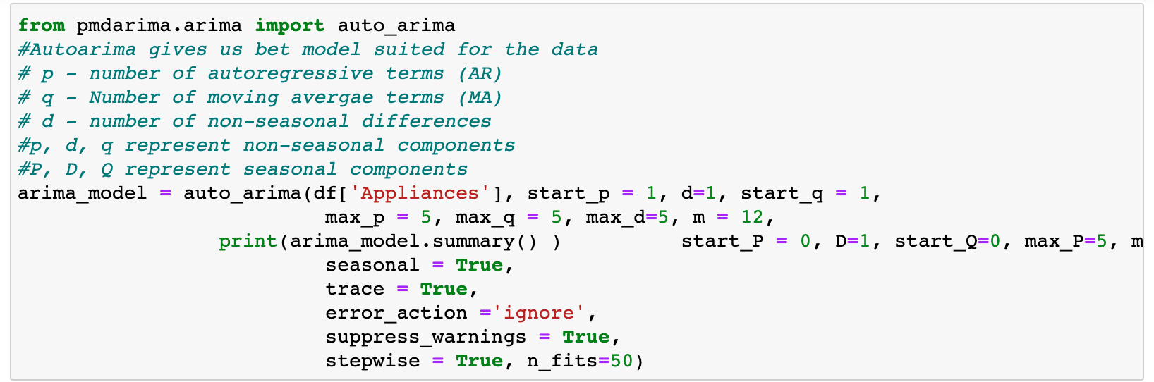
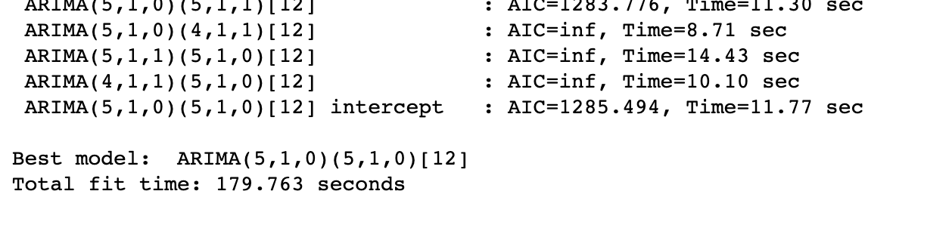
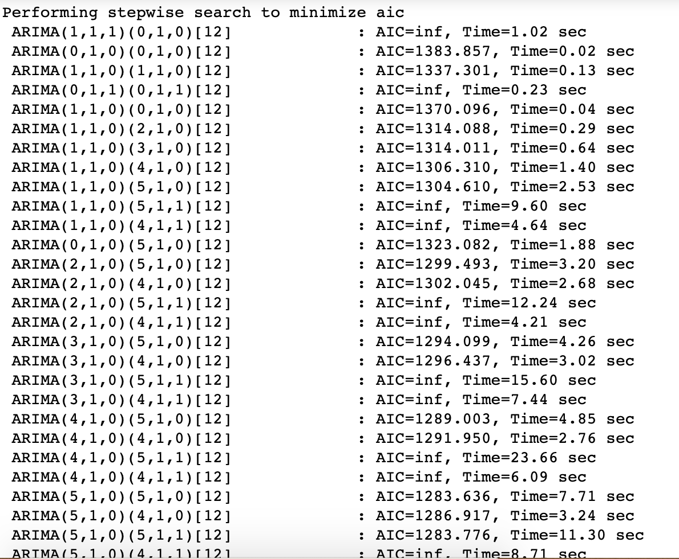
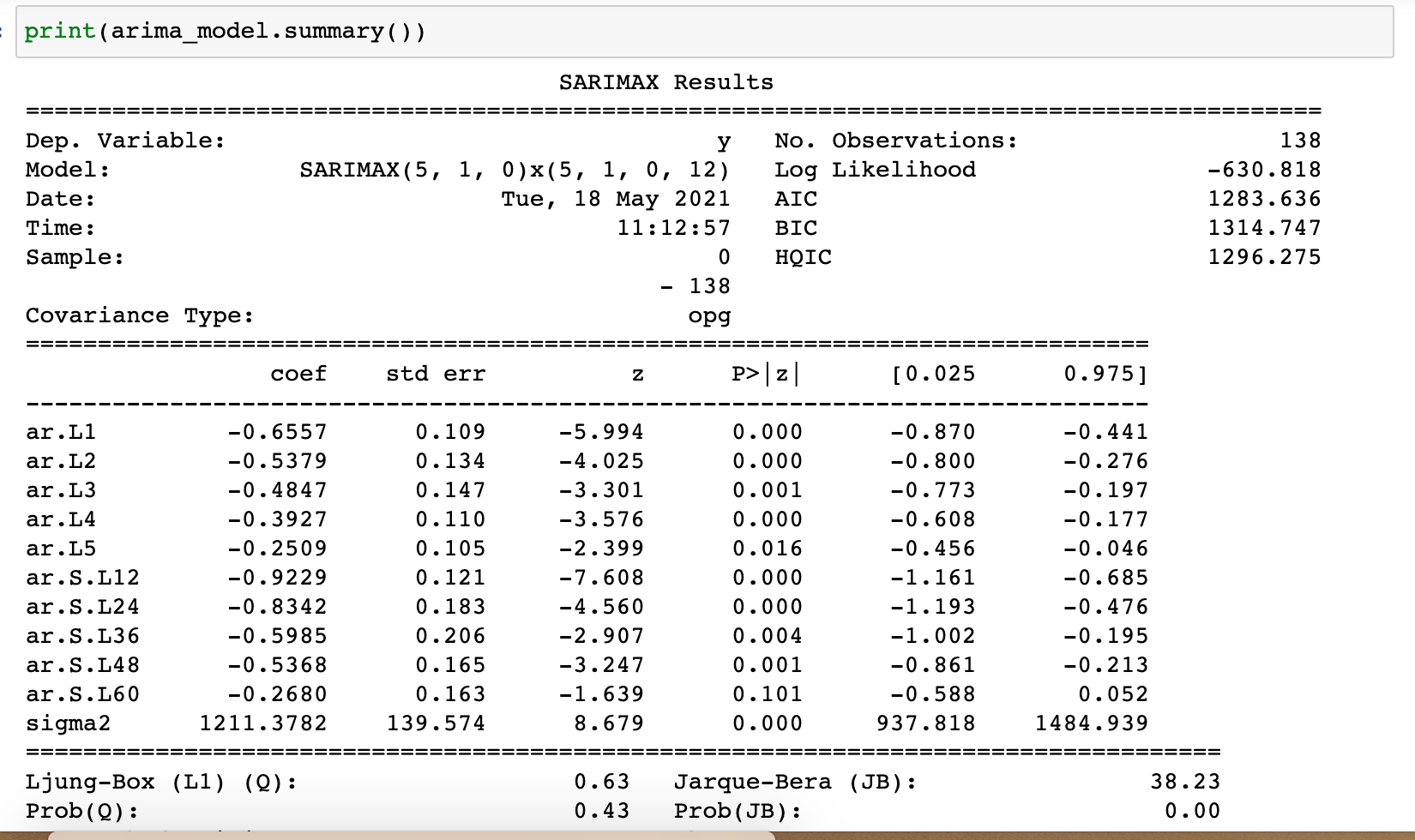
MODEL Implementation

Slide 11
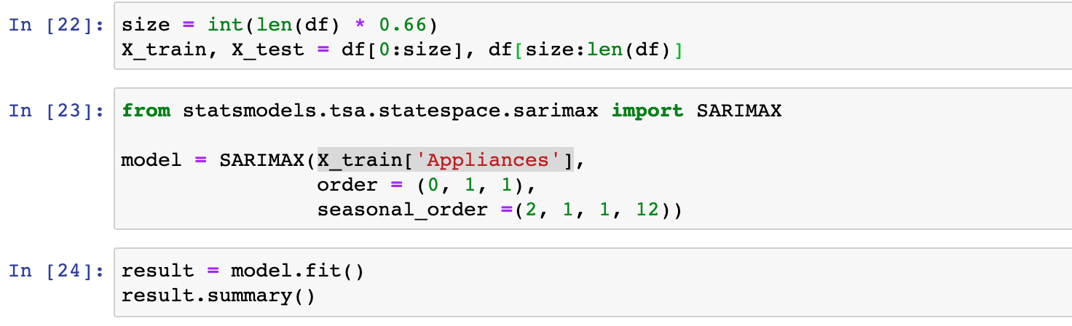
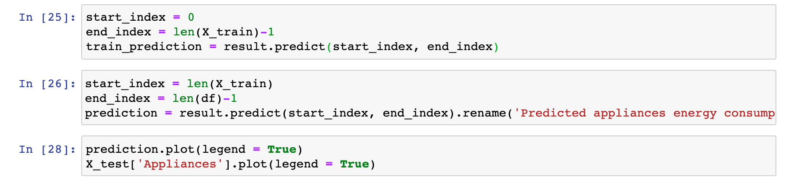
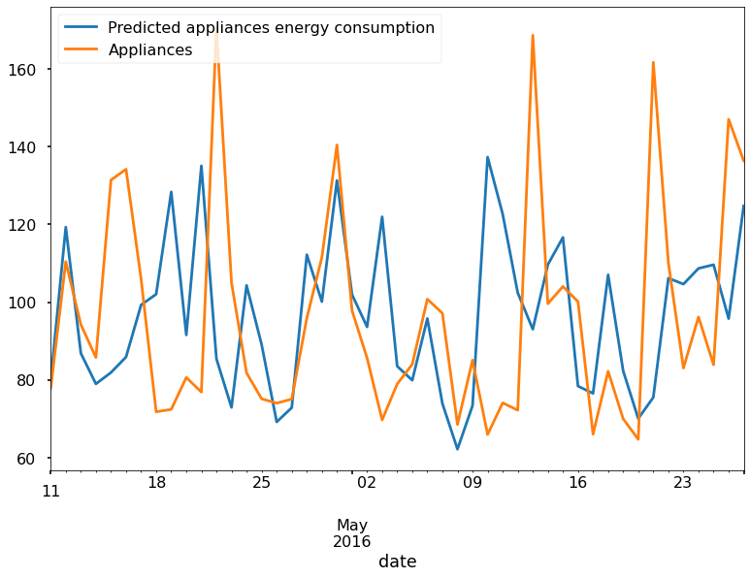
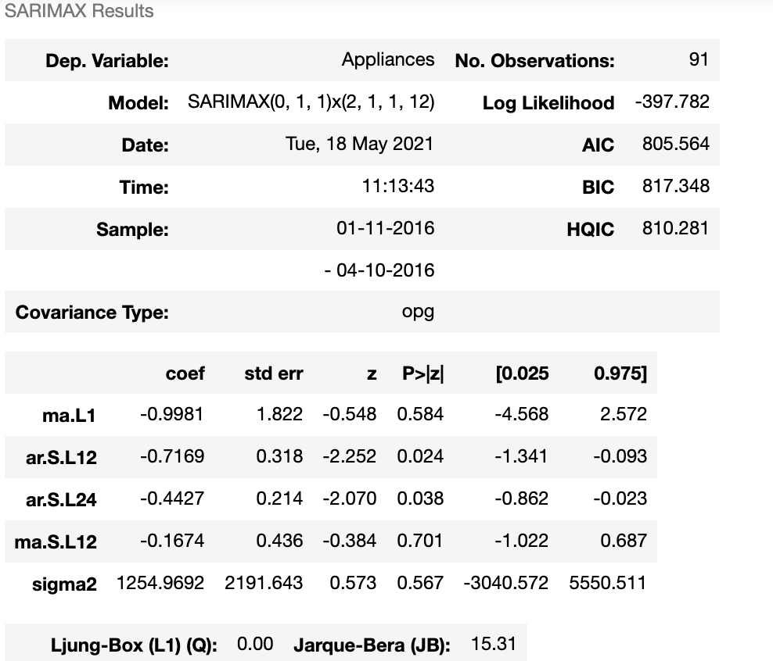
SARIMAX PREDICTION

Slide 12
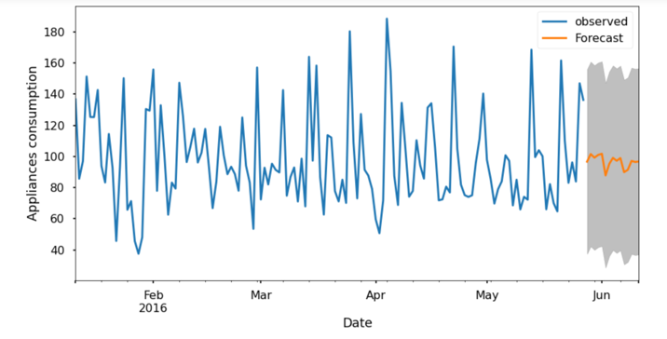
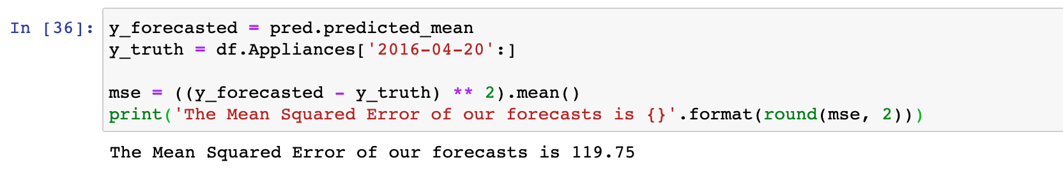
Forecast

Slide 13
MODEL 2: Long Short-Term Memory (LSTM)
Special kind of Recurrent Neural Network
Designated to overcome limitations of RNNS such as:
Complex training
Difficulty to process very long sequences
Example: The sky is _____ (Ans: blue) but This is 11th day of Wildfires in SFO bay area, there is smoke everywhere, it is snowing ash everywhere and the sky is ____ (Ans: red) .
Remembering information for long periods of time is intrinsic to LSTM

Slide 14
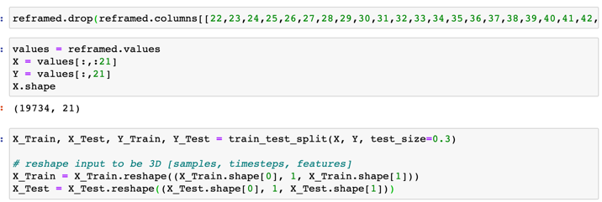
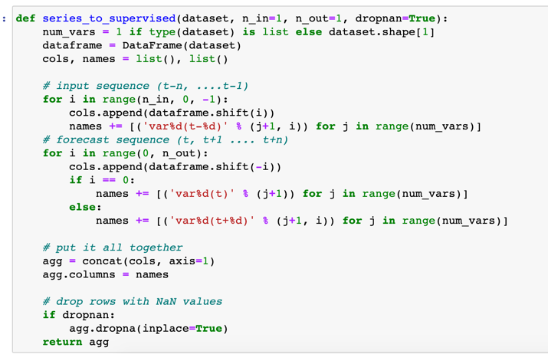
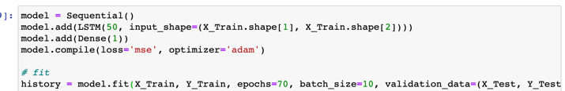
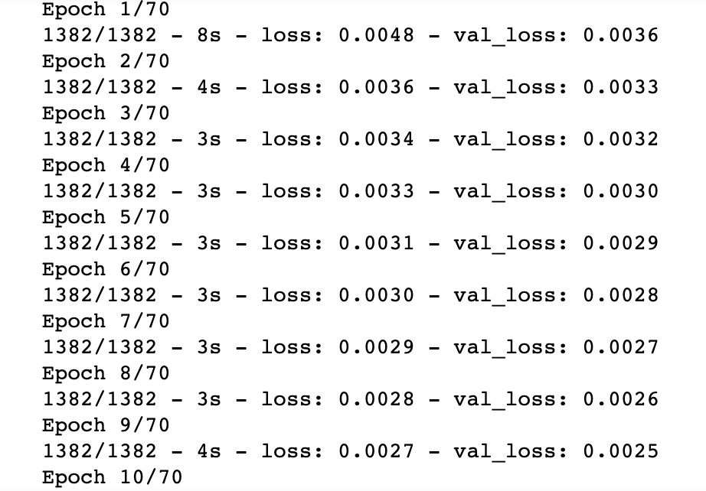
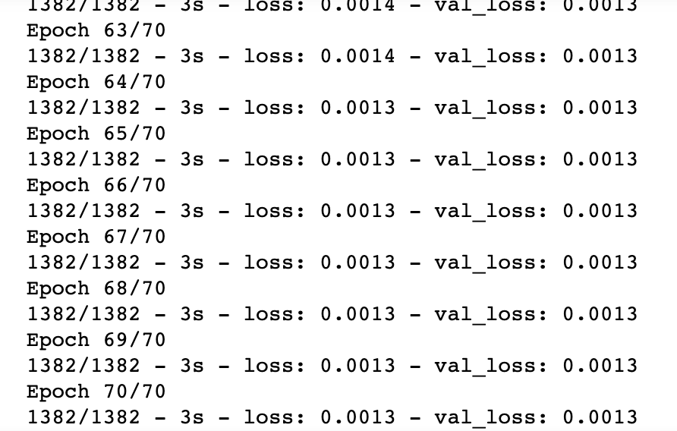
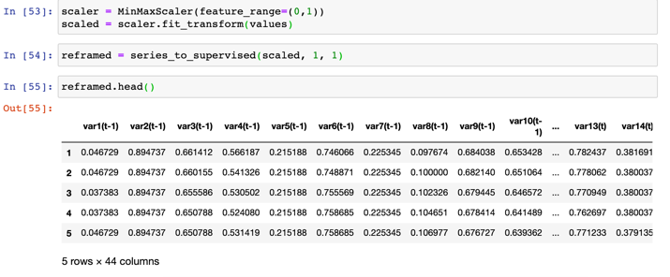
Data Preparation & MODEL Development

Slide 15
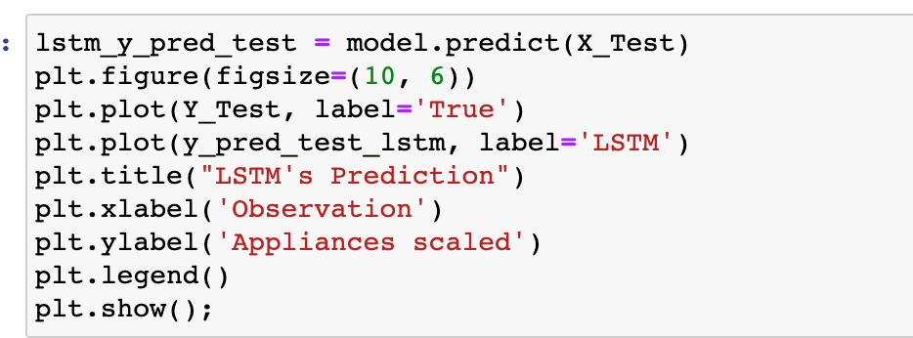
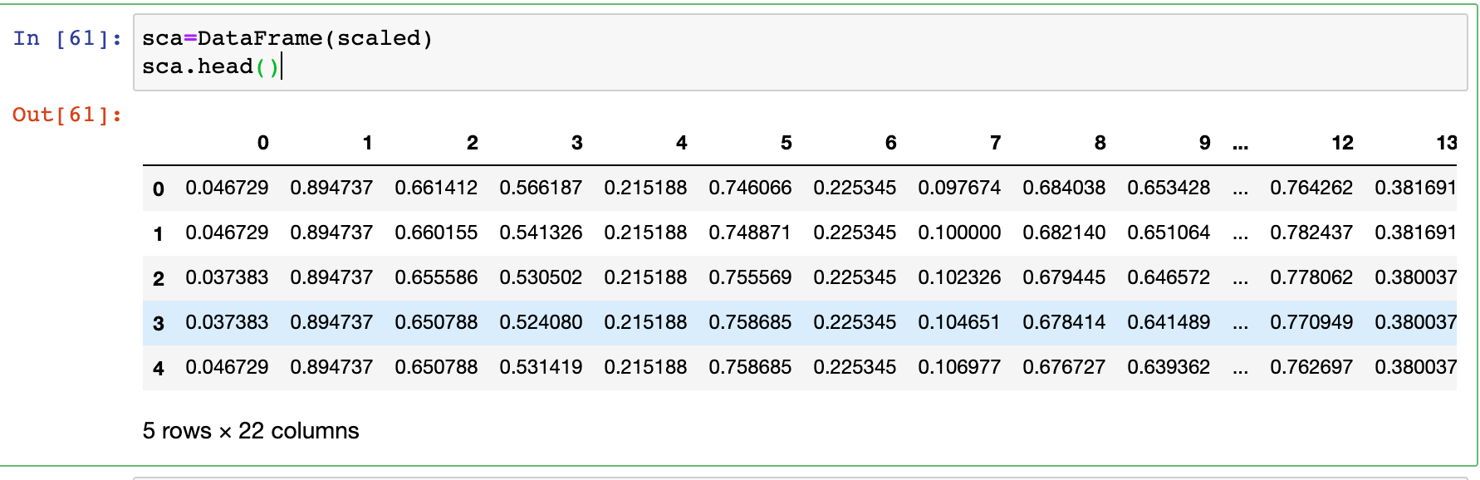
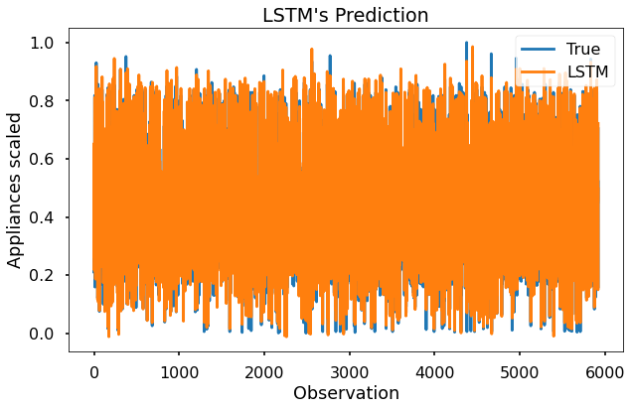
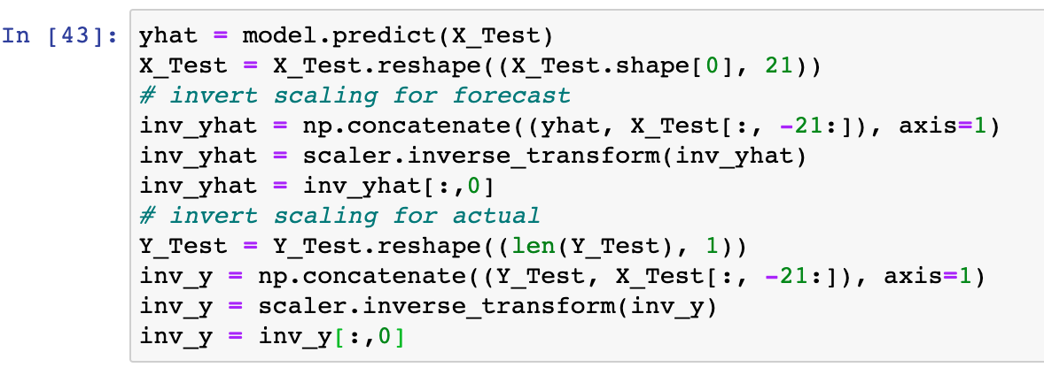
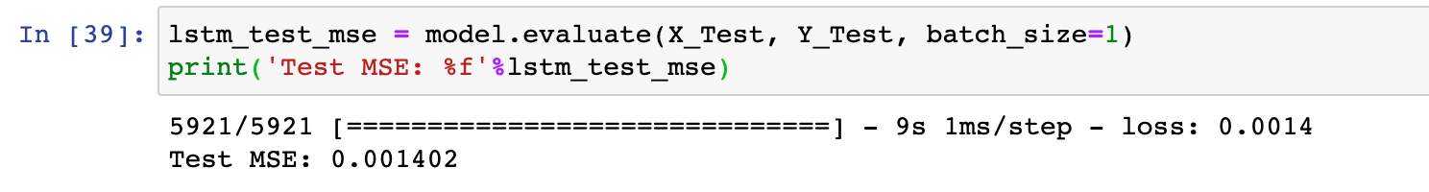
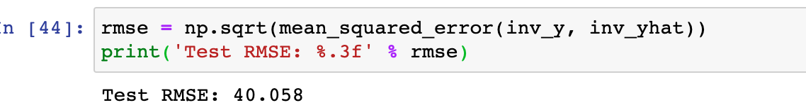
LSTM Forecast

Slide 16
Metric RESULTS
Model | Root Mean Square Error (RMSE) | Mean Squared Error (MSE)
LSTM | 40.058 | 0.0014
SARIMAX | 10.94 | 119.75

Slide 17
Lessons Learned
Time Management
Implementation/Development
- Explore more models and metrics
Choice of dataset

Slide 18
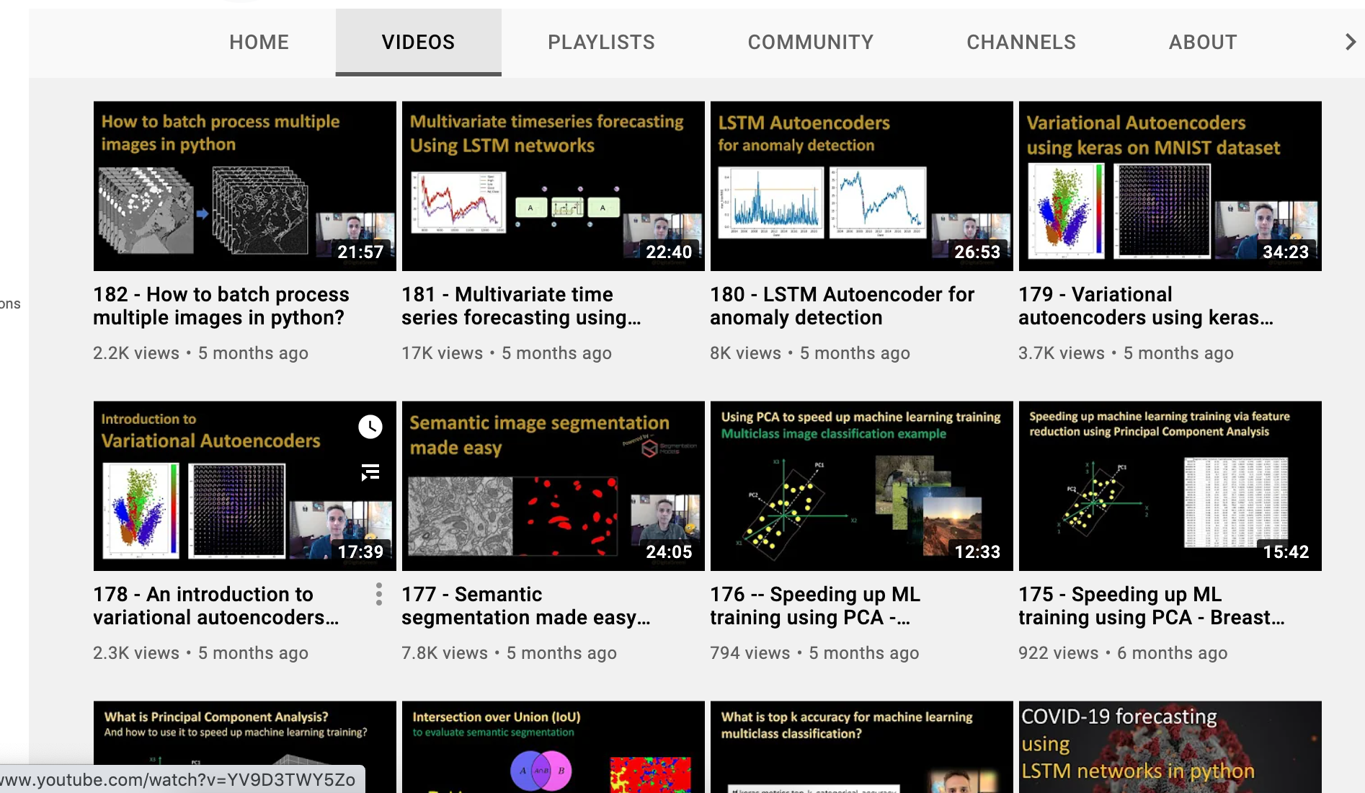
References
https://machinelearningmastery.com/time-series-forecasting-methods-in-python-cheat-sheet/ - Machine Learning Mastery
YouTube videos by DigitalSreeni

Slide 19
Questions?

